Slide 1
Processing the results of the 2024 employee satisfaction survey for Umeå University

Slide 2
How the results will be processed
Add the action plan to your operational plan no later than on 18 December 2024.
The employee satisfaction survey is open
between 26 February and 15 March 2024.
Processing at a local collaborative group (LSG).
Summarise prioritised measures in your department’s, office’s or equivalent unit’s action plan for systematic work environment and active measures and inform your line manager and staff.
Follow up the action plan continuously, for instance at each workplace meeting.
Managers can access their results
between 1 April and 31 May 2024.
Analyse and discuss the results in your management team, work environment team or equivalent forum.
Discuss the results and produce prioritised measures through group work at a workplace meeting.
Present and discussion the results with your staff at a workplace meeting.

Slide 3
What is expected of me as a manager?
Read your results.
Analyse and discuss the results with your line manager or management team, and HR officer, work environment group (management support for equal opportunities, work environment representative) or equivalent.
Make use of your HR or work environment group and plan a presentation for a workplace meeting. Plan at least three dates at which you can work with the results. Book a time and a place for these sessions well in advance.
Meeting 1 – Present the results to your staff. Describe the process going forward and the purpose of the upcoming workshop.
Meeting 2 – The workshop is aimed to produce prioritised measures together at the department, office or equivalent.
Document – summarise the prioritised measures in your action plan for systematic work environment and active measures together with your management team and the work environment team or equivalent. Inform your line manager.
Meeting 3 – Report the status of the prioritised measures from the action plan to your staff.
Process the action plan at a local collaborative group (LSG).
Enclose the action plan with your operational plan (VP). Follow up the action plan continuously, for instance at every workplace meeting.

Slide 4
Roles when processing the results
Role of the manager:
Be responsible for producing and implementing measures to improve the chosen workplace climate issues.
Be the instigating party when it comes to improvements to the workplace climate at the department, office or equivalent and pick out your own areas of improvement in your leadership including activities.
Role of each staff member:
Actively contribute to and participate in the subsequent process.
Role of the work environment representative:
Be a sounding board for the manager when planning, implementing and producing suggested measures.
Be a representative of the staff members.

Slide 5
Support from HR officers and management support for equal opportunities
– Provide extra support to managers with low results scores.
– Support in using the results portal.
– Provide additional analyses from the results portal.
– Be a sounding board for managers when analysing the results and before presenting the results.
– Aid in planning and implementing.
– Support group discussions on results and producing measures to the department’s, office’s or equivalent unit’s action plan for systematic work environment and active measures.
– Support and offer guidance when presenting the department’s, office’s or equivalent unit’s results.
– Aid with knowledge and tools concerning work environment management and active measures.
– Be a sounding board in discussions on what management skills improvements can be made.

Slide 6
Important questions when analysing your results
What patterns are there?
Where are the strengths?
Are there any areas that can be improved?
Which issue is the most important one to start off with at the department, office or equivalent based on its needs?
Your leadership results are your own. They offer a good opportunity to improve your leadership.
Do not attempt to identify who has submitted each response.
Analyse – React – Act.

Slide 7
Important recommendations when presenting the results to your staff
Present the results in a neutral tone without adding any judgements.
Focus on the workplace climate but show other areas too.
Encourage everyone to write down the strengths and areas of improvement they spot during the presentation of the results.
Encourage a discussion on the existing strengths and areas of improvement at your department, office or equivalent.
Do not get stuck in discussions on how questions were formulated.
Park issues that you cannot influence.
Be curious and open.
Welcome a dialogue by asking open questions.
– How can we achieve that?
– Can you give an example?
Do not suggest solutions – not even if you see them.
Indicate that all issues are important – but prioritise what issue is most important to start off with.
See the results processing as a leadership exercise.
Present the next step of the process.

Slide 8
Preparing for the workshop
Read your results, analyse and consider your strengths and areas of improvement (i.e. low and high scores). What areas do you think should be prioritised in your organisation?
Invite your staff to a workshop well in advance to allow as many staff members as possible to attend.
Book premises that allow group work.
Prepare with sweets, fruit or cake, for instance.
Make sure you have pens and post-it notes in various colours.
If you think you will be short on time, you can distribute the results a few days in advance to allow your staff to look through the results themselves before the workshop.
Make a few notes from the results and ask your line manager, HR officer or management support for equal opportunities for help when analysing the results.
Ensure that you know how to interpret the results and how the results portal works before the workshop.

Slide 9
Workshop

Slide 10
Programme
Introduction
Present the employee satisfaction survey results
Break (10 min)
Divide into small groups
Describe the task of the group work
Group work
Break (10 min)
Full-group gathering and reflection
Conclusion – what will happen next?

Slide 11
Group division
Groups of five can be appropriate.
Select one person per group as an “Administrator” responsible for taking notes and gathering everyone’s views.
Select one person as a “Presenter” to present the group’s shared views to the bigger group.

Slide 12
Describe the objective of the group work
Go through the results – focus on the workplace climate area, and make suggestions where you can make a difference.
Focus Workplace climate – put your energy into what you can influence – postpone discussions on any other issues.
The Leadership area will first be dealt with by the manager. Share one or two post-it notes containing areas of improvement or strengths. These post-it notes will be collected at the end of the workshop and will form an important part of the leadership development for line managers.
The Organisation and Vision areas will primarily be dealt with on management team level. Share one or two post-it notes containing areas of improvement or strengths. These post-it notes will be collected at the end of the workshop and will form an important part of the management team’s development activities.
Discrimination issues will be processed separately in the management team and the work environment team or equivalent. This work must also include the management support for equal opportunities.
Attach a picture from your results.

Slide 13
Prioritisation matrix
High impact | Execute immediately! (Highest urgency) | Plan
Low impact | Hold on | Avoid (Lowest urgency)
 | Easy to implement | Hard to implement
Use the prioritisation matrix to sort and prioritise among the proposed measures.
Questions to “park”. (This is not relevant here and now, but good to remember.) | To the next level (This is something I must discuss with my line manager)

Slide 14
Reflect individually
Which are the three most important questions/areas to develop on (areas of improvement) when it comes to workplace climate?
Which are the three most important questions/areas to preserve (strengths/positive aspects) when it comes to workplace climate?

Slide 15
Present and sort
Each person presents their proposals of strengths and areas of improvement – these are documented by the ”Administrator”. Use post-it notes to document.
When everyone has presented their post-it notes, group any issues or areas that are linked together and divide them into strengths and areas of improvement.
Improvements
Strengths

Slide 16
Prioritise and discuss
Focus on areas of improvement.
Select which issues or areas are most important for you to prioritise (1, 2 and 3).
Discuss: – What is the background behind this not working the way we want? – What do we want to achieve by working on this? What is our end goal?
– Which activities should be implemented to reach those goals or to develop?
Document measures in the department’s, office’s or equivalent unit’s action plan for systematic work environment management and active measures.

Slide 17
Sharing thoughts
Each group briefly presents what their group discussions have focused on.
How did it go?
Which areas of improvement have you discussed?
Do you have any other thoughts you wish to share?

Slide 18
Action plan for LSG and VP
After workshop
Discuss all proposals and prioritisations from the workshop with the management team, the work environment team or equivalent.
The most highly prioritised measures that cannot be solved immediately are documented in the department’s, office’s or equivalent unit’s action plan for systematic work environment and active measures, which you can continue to work with in the upcoming year or years.
The action plan must be processed at a local collaborative group (LSG) and must be enclosed with the operational plan (VP).

Slide 19
Examples- Action plan for systematic work environment management and active measures, part 1
Identified risks and obstacles | Analysis of reasons behind risks and obstacles | Low risk | Medium risk | High risk
Example 1: Risk of stress-related ill health | Unclear who is responsible for certain tasks. | ☐ | ☐ | x
Example 2: Risk of discrimination based on disability (active measures for employers – working conditions) | A person in a wheelchair cannot access the photocopy room. | ☐ | ☐ | x
Example 3: Risk of neck, shoulder or back pain | The workspace in the lab is too low for tall individuals. | ☐ | x | ☐
Example 4: Risk of threatening situations | Unlocked doors and few staff present in the premises in the afternoons make staff feel exposed if unauthorised visitors become threatening. | ☐ | x | ☐
Examples

Slide 20
Examples - Action plan for systematic work environment management and active measures, part 2
State prioritised risks/obstacles or areas of improvement | Goal – what do you wish to achieve? | Measures – what will you do to achieve your goal? | Person in charge of the measure | Completed by (date)
Example 1: Risk of stress-related ill health due to vague responsibilities | Reduce the experienced level of stress. | Conduct Prevent’s survey on organisational and social work environment. Clarify areas of responsibility among staff. Conduct a renewed Prevent survey in six month’s time to follow up. | Manager with the support of HR and the work environment representative | 30 June 2023
Example 2: Risk of discrimination based on disability (active measures for employers – working conditions) due to narrow access to photocopier | All authorised students and staff must have access to the photocopier. | Report the problem to the landlord (Akademiska Hus). Follow-up at workplace meetings. | Manager with the support of HR and the work environment representative | 30 June 2023
Example 3: Risk of neck, shoulder or back pain due to low workspace in lab | The workspace in the lab must be adapted to suit all authorised students and staff. | Purchase a vertically adjustable worktop for the lab. Follow-up at workplace meetings. | Manager with the support of HR and the work environment representative | 31 December 2023
Example 4: Risk of threatening situations due to unlocked doors and few staff present | All authorised members of staff must be able to feel safe when working alone in the premises. | Doors are locked from 15:00 every day. Visitors are asked to book an appointment with whomever they wish to see. Follow-up at workplace meetings. | Manager with the support of HR and the work environment representative | 28 October 2022
Examples
Select the risks or areas of improvement (from the analysis on the previous page) that you have chosen to prioritise this year.

Slide 21
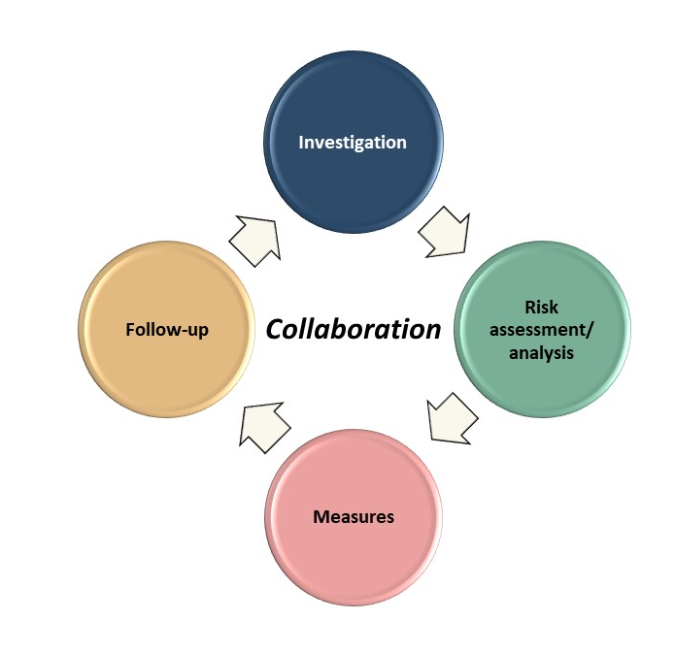
Regular follow-up
Follow up measures for the upcoming year or years:
Have we achieved our goals or implemented the measures? ​
Why or why not?​
What is the next step? ​
Do any of the activities need to be revised or clarified?​
The follow-up must be documented in the action plan.
Regularly consider these points:​
Do we feel that the activities have the desired effect on the chosen area of improvement? If not, what can we do differently?​
When a measure has had the desired effect, implementation of the next measure in the order of priorities can commence.

