Slide 1
Explaining the results
Umeå University’s 2024 employee satisfaction survey
2024-01-04 Personalenheten

Slide 2
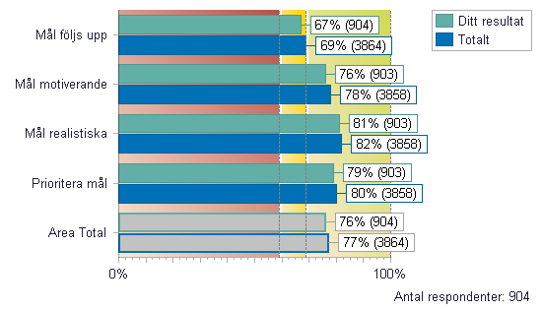
Result reports
Anonymous results reported When the employee satisfaction survey has been completed, managers can create reports for their parts of the organisation. The system is set to automatically block results from being shown if the minimum number of responses has not been met.
Anonymity limits If the manager’s results, or the results a manager is filtering out, have: eight or more responses, the manager can see the results on all questions (excluding background variables and exposure to undesirable behaviour). The results show index values (image 1) and spread of answers (image 2).
Image 1 Image 2
If the manager’s results, or the results a manager is filtering out, have: five to seven responses, the manager can only see the results on the index questions (image 1), but not spread (image 2).

Slide 3
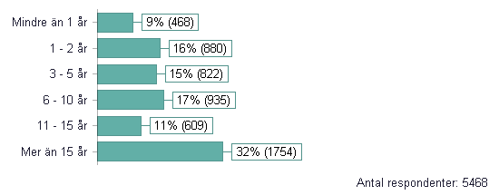
Background variables in full report
Results based on background variables
The reason for using results based on background variables in an employee satisfaction survey is to break down the total results based on variables such as gender or employment time to see if satisfaction differs between women and men, or to ensure that staff with different employment time are attracted. HR support functions on faculty or university-wide level will be able to produce results based on background variables if at least eight responses have been submitted.

Slide 4
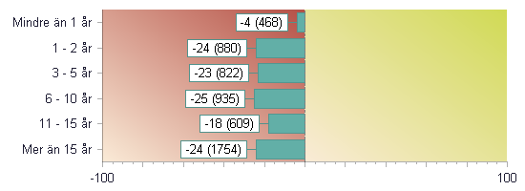
eNPS from various perspectives
Comment:
The diagrams show the eNPS (Employee Net Promoter Score) distribution for the background variables gender and employment time. If a group is missing from the diagram, this is because fewer than five responses were submitted for that group.

Slide 5
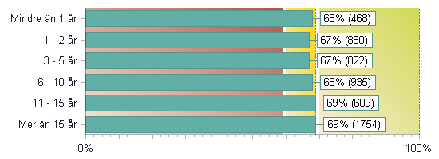
Employee index from various perspectives
Comment:
The diagrams show the total employee index, which is the total employee satisfaction based on the given background variables, such as gender and employment time, for instance.

