Slide 1
Employee satisfaction survey 2024
What has happened since last time?​
How can we work together?
Human Resources Office, Umeå University

Slide 2
Background
Why do we conduct employee satisfaction surveys?
Human Resources Office, Umeå University

Slide 3
BACKGROUND AND OBJECTIVES
Background​ Umeå University conducts employee satisfaction surveys every three years.​
Objective​ It provides the Vice-Chancellor, who is responsible for the University’s overall work environment, with an overview of how staff at Umeå University experience their work environment.​
Heads of department or other managers gain an overview of how staff experience the work environment at their departments, offices or equivalent.​
It is a part of the University’s systematic work environment undertakings and active measures.​
Results form basis for improvements on all organisational levels at the University. ​
Aim​ Promote a healthy work environment on equal terms.

Slide 4
Short facts
The most recent employee satisfaction survey was conducted in 2021.​
Results from the 2024 survey will be comparable with 2018 and the benchmark. ​
The survey:​
Open between 26 February and 15 March 2024.​
The survey takes between 15 and 20 minutes to complete.​
The survey is available in Swedish and English.​
The name of the line manager (nearest manager with personnel responsibilities) is stated explicitly in the survey.​
Responses are processed and summarised by Quicksearch.​
Quicksearch guarantees full anonymity.​
Groups consisting of five respondents or more receive group results.​
New feature: scholarship holders can participate.​
Results are presented in April. ​
In 2024, prioritised measures will be documented in the department’s, office’s or equivalent unit’s Action plan for systematic work environment and active measures.​
The action plan must be enclosed in the 2025 operational plan.
Notes:
Briefly describe the process for 2024.

Slide 5
Why should you respond to the survey?
It is an opportunity to share your views on your work environment, leadership and organisation.​
Contribute with your experiences – the higher the response rate, the more reliable the results get.​
Contribute to a better work environment and operational development.
Notes:
Discuss advantages and disadvantages with responding to the survey. Attempt to conclude by stating that this is an opportunity for individuals to make their voice heard and to contribute to improving the department, office or equivalent. If anyone expresses concerns about its impact, describe how you have worked with the results from previous surveys and give examples of improvements. For your information, the Work Environment Committee also works on making university-wide improvements based on the results of the employee satisfaction survey to contribute to a more sustainable and equal work and study environment (see the University-wide action plan for systematic work environment management and active measures 2022–2024).

Slide 6
What has happened since the last survey?
What measures were prioritised in 2021?​
Has anything improved?
Human Resources Office, Umeå University

Slide 7
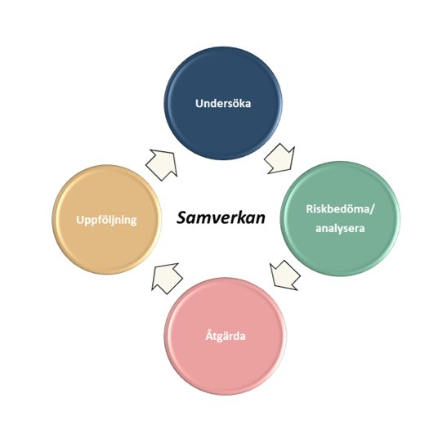
A part of systematic work environment management
Notes:
Remind your colleagues that the employee satisfaction survey is a part of the University’s systematic work environment management and active measures. All employers are obliged to make systematic work environment undertakings and take active measures, in accordance with the Swedish Work Environment Act and the Discrimination Act. Follow the steps in the department’s, office’s or equivalent unit’s action plan for systematic work environment and active measures.

Slide 8
Go through your prioritised measures from your action plan
Insert information from your 2021 action plan.
Notes:
Describe how you have worked with the results from the 2021 survey and show the measures that were prioritised in the action plan that was submitted in the operational plan.​
Go through each measure, summarise what has been done and follow up if the measure has had the desired effect, for instance by the show of hands.​
If you have tried various measures, describe them. For instance, if you immediately noticed that a measure had adverse effects and you decided to modify or change measures. If your members of staff have been involved in making decisions, remind them. For instance, if you decided to revise a measure at a workplace meeting.​
If you have conducted any additional measurement in between to follow up certain measures, please present the results linked to each measure.

Slide 9
Activities after the results
Meeting 1: Inform the group about the results of the employee satisfaction survey.​
Meeting 2: Hold a workshop. Discuss the results in groups and prioritise a maximum of three risks and propose measures to amend them.​
Meeting 3: Summarise and discuss a selection of prioritised measures for the action plan.
Notes:
It is advisable that you start planning these meetings now. Book two or three dates and a venue to: ​
Present the results, and depending on the time you have for each session, meeting one and two can be combined into one morning or afternoon session.​
Workshop​.
Follow up.

Slide 10
Roles and responsibilities
Manager: Informing and presenting results. Working with the results. Ensuring that an action plan is produced and followed up – including risk assessments, analyses, targets, measures, responsibilities and time plan.​
Staff: Responding to the survey, proposing improvements, participating in follow-up discussions/action plan and contributing to implement various measures.​
Human resources: Providing practical support and being a sounding board to the head of department or equivalent manager throughout the process. ​
Equal opportunities representatives: Providing practical support and being a sounding board to the head of department or equivalent manager focusing on active measures.​
Work environment representative: Representing the staff. Collaborating and being a sounding board throughout the process.​
Everyone’s responsibility: Contributing to positive and constructive discussions, and proposing possible improvements.
Notes:
Present the various roles to ensure that everyone knows what role they play and emphasise that everyone is needed to ensure that the follow-up work after the survey succeeds.

Slide 11
Summary of process and time plan
Follow up measures
Implementmeasures
Inform
January–February (before survey opens)
Continuously
2024
2024
May–December (enclose action plan with operational plan)
Develop an action plan
Survey is open
26 February until 15 March
Present results
April–June

Slide 12
For staff, in English:
https://www.aurora.umu.se/en/my-employment/work-environment-health-and-equal-opportunities/work-environment/employee-survey/
For staff, in Swedish:
https://www.aurora.umu.se/en/my-employment/work-environment-health-and-equal-opportunities/work-environment/employee-survey/
For managers, in Swedish:
https://www.aurora.umu.se/stod-och-service/administration-och-chef/hr-guiden/arbetsmiljo-och-lika-villkor/medarbetarundersokning/
Notes:
On these pages, you can find more information.

